Slide 1
FINANCIAL AID

Slide 2
Applying for Financial Aid
Who Should Apply
FAFSA – www.fafsa.org
(Free Application for Federal Student Aid)
UWF school code 003955
IRS Data Retrieval Tool
Oct. 1, 2016 – 17-18 FAFSA Available
College Goal Event at UWF – Nov. 19

Slide 3
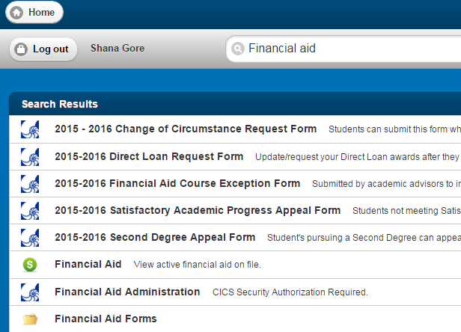
Your Financial Aid Award
Notification Beginning in March
You must be admitted prior to award
Award Letter
Email notification
MyUWF Portal
my.uwf.edu
View missing requirements
Accept/Decline Awards
UWF Scholarship Portal

Slide 4
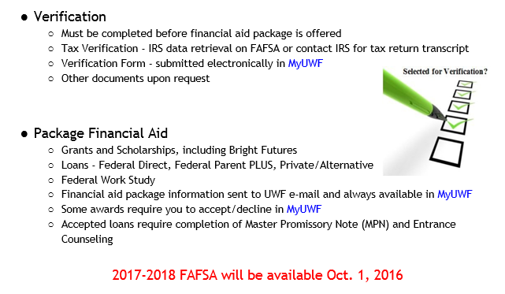
What happens in our office?

Slide 5
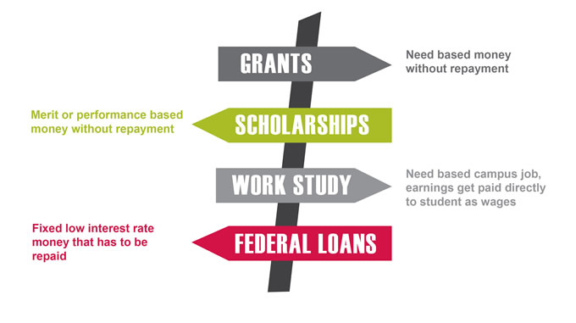
Types of Aid

Slide 6
Disbursement and Refunds

Slide 7
Course Exception and Attendance Confirmation
Attendance Confirmed via Class Mate app in MyUWF.
Must be confirmed within 7 says of the course start date in order for financial aid to disburse on normal timeline.
Different POT can delay disbursement until all classes have started
Advisors have access to Course Exception form via MyUWF.
Course Exception form should only be used if updating Degree Works is not possible.

Slide 8
SALT – www.saltmoney.org/UWF
www.saltmoney.org/uwf - sign up for your free account.
Financial Literacy
Scholarship Search
Internship Opportunities
Student Loan Borrowing assistance

Slide 9
Contact Information
Financial Aid – Building 18
uwf.edu/finaid
finaid@uwf.edu
(850) 474-2400
us on Facebook – UWF Financial Aid
Student Accounts/Cashier’s Office – Building 20E
uwf.edu/financial/studentaccounts
stuacct@uwf.edu
(850) 474-3037/3038

Slide 10
Questions?

