Slide 1
LaTeX Resume / CV Workshop
Nov 16, 2018

Slide 2
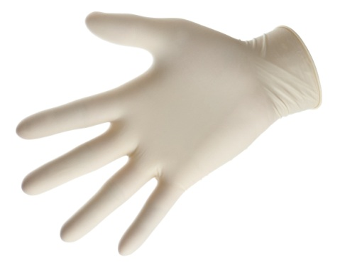
Why LaTeX (Lay-Tech)?
LaTeX documents are gorgeous.
Better typography than Microsoft Word
Can make any type of document that you can imagine
Free!

Slide 3
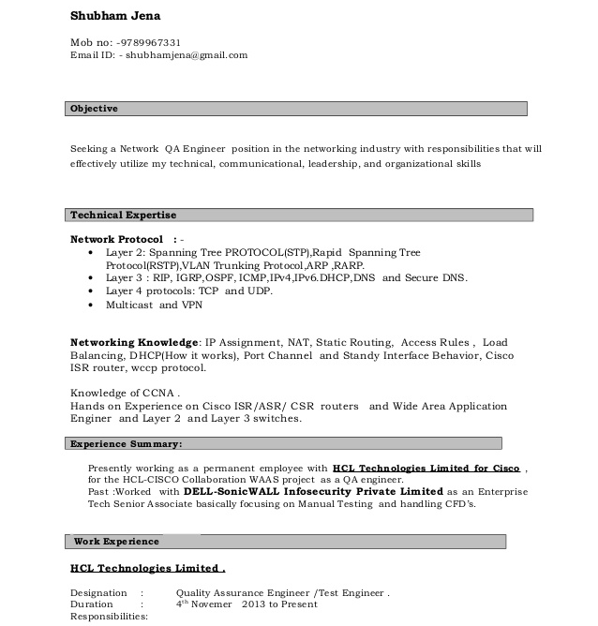
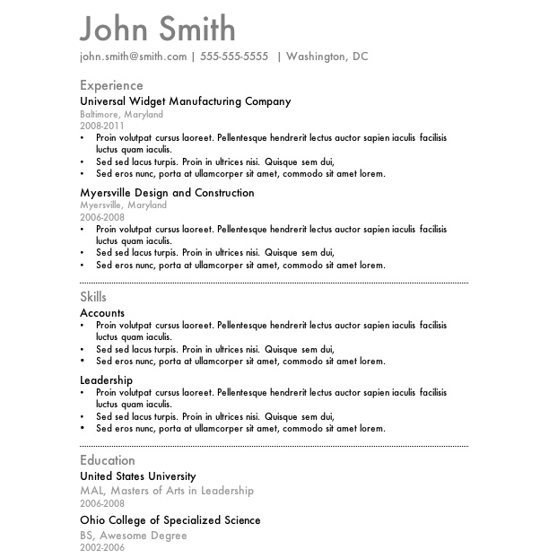
What’s wrong with Word?
Spacing and form imposed by font and program
Columns, lists and tables are TERRIBLE
Not customizable

Slide 4
What do I need to code?
Coding requires
Text editor: this is where you write the code
Compiler: this is what reads the code and makes it into a PDF

Slide 5
How will this work?
We tell LaTeX
What we want the document to look like (Document Class)
Where we want things on the page (Position commands like “\hspace{0.5cm}”)
What it should say (we type the words we want on the page)

Slide 6
Getting Started
http://pages.uwf.edu/cvarney/latex.html
Use Overleaf to get started
Later on (for the advanced user):
Download LaTeX
Download an editor

Slide 7
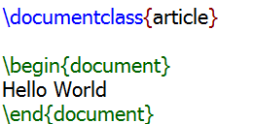
Creating a New LaTeX File
Type the following into a new document:
LaTeX files have the filename extension .tex
Save it as hello.tex
Hit the Green arrow
This will create a pdf called hello.pdf

Slide 8
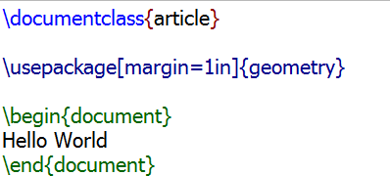
Creating a New LaTeX File
Make a small change:
Create the pdf again. What changed?

Slide 9
Resume/CV Options
Res
AwesomeCV
ModernCV
TwentySecondCV
Medium Length Professional CV
AND MORE
https://www.overleaf.com/gallery/tagged/cv

Slide 10
The Resume Class res.cls
If you installed LaTeX on your computer, it should automatically install res.cls for you.
If not, you can find it @
https://ctan.org/pkg/res?lang=en
If you have to download res.cls, it MUST go in the same directory as your LaTeX file
Overleaf does not have res.cls. You have to upload the file

Slide 11
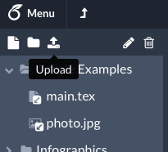
Uploading res.cls

Slide 12
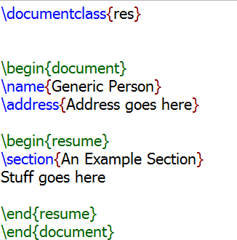
Create a New Resume
Create a new document and type the following:

Slide 13
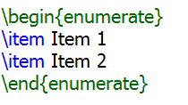
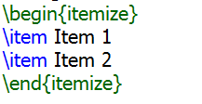
Lists / Bullet Points
Numbered lists are created using the enumerate environment
Bulleted lists are created using the itemize environment
Add one of these under the section we created

Slide 14
Making Lists Better
To improve the way lists work, we can use the enumitem package
This line of code goes after \documentclass
We can customize anything about the list
Change your list to look like this:

Slide 15
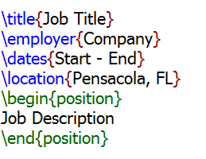
Adding Positions
The resume class has a command to create a position with a job description.
Create a new section called “Work Experience”
Add the following:

Slide 16
Finding a Style
I created a template that uses all of the basic elements of res.cls:
Lots of examples on using res.cls to generate different styles: https://www.rpi.edu/dept/arc/training/latex/resumes/
Take a look at the PDFs and see if there’s a style you like

Slide 17
Other CV Styles
LaTeX is really customizable, so there are lots of resume and CV packages available: https://www.overleaf.com/gallery/tagged/cv
Comprehensive TeX Archive Network: http://www.ctan.org/
Windows: MiKTeX will automatically download missing packages
Linux/MacOS: Default install covers most packages

Slide 18
Learning More
You can do just about any type of document with LaTeX
Many scientific journals use or require LaTeX for publication
Check out https://en.wikibooks.org/wiki/LaTeX

